Slide 1
Capability Capsule 能力胶囊
Part A · Function: What this buys AI4Research. Section a of the post-presentation record, shown on its own.
Muk Chunpongtong · post presentation, 2026-09-24
Notes:
TIME 0:20
SAY: Main points:
- Part A answers requirement a: what CC is for
- Three slides: why a capability layer, why AI4Research needs it, and the four verbs as they stand today

Slide 2
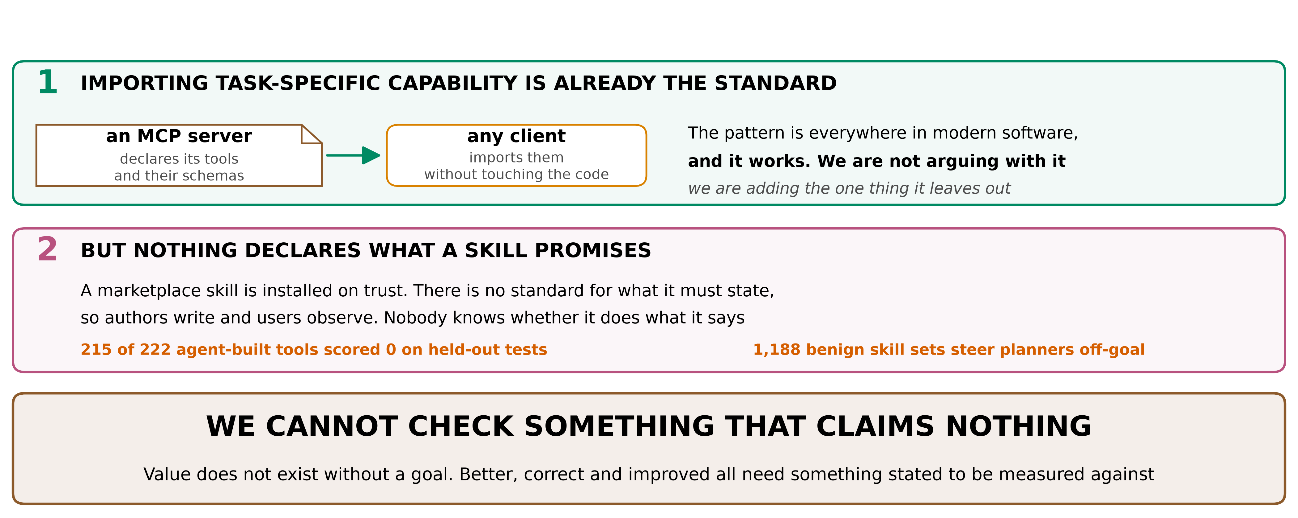
A · FUNCTION
Why a capability layer at all
• Two reasons, and the line underneath both
• First, importing task-specific capability is already how this is done. An MCP server declares its tools and...
merged/SCHEMA.md §0.1. Study values printed in their own tables
2
Notes:
TIME 2:00
SAY: Main points:
- Two reasons, and the line underneath both
- First, importing task-specific capability is already how this is done. An MCP server declares its tools and their schemas, and any client imports them without touching the code. The pattern is everywhere in modern software and it works. We are not arguing with it, we are adding the one thing it leaves out
- Second, nothing declares what a skill promises. A marketplace skill is installed on trust, there is no standard for what it must state, so authors write and users observe
- So we cannot check something that claims nothing. That is the whole argument for making authors declare
Supplemental points:
- The measured version of that: 215 of 222 agent-built tools scored zero on held-out tests of the job they claimed, and SkillFuzz found 1,188 benign skill sets that steer a planner off-goal
- The deeper version: value does not exist without a goal. Better, correct and improved are not properties of code, they are relations between code and something stated. With no declaration there is nothing to measure against, so there is no verification and no self-improvement either

Slide 3
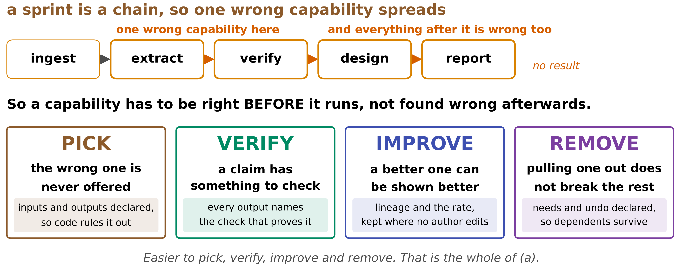
◆ A · FUNCTION
Why AI4Research needs this
• A research sprint is a chain, so a wrong capability early poisons every stage after it
• Four verbs, each bought by a declared field, not by a convention
merged/REPORT.md §2a
3
Notes:
TIME 2:00
SAY: Main points:
- A research sprint is a chain, so a wrong capability early poisons every stage after it
- Four verbs, each bought by a declared field, not by a convention
- PICK: inputs and outputs are declared, so code rules out what cannot fit, before a model ranks anything
- VERIFY: every output names the check that proves it, so a claim always has a target
- IMPROVE: lineage and a success rate are kept where no author can edit them, so better is demonstrable
- REMOVE: needs and undo are declared, so pulling one out does not silently break its dependents
Supplemental points:
- The whole of requirement a is those four verbs getting cheaper

Slide 4
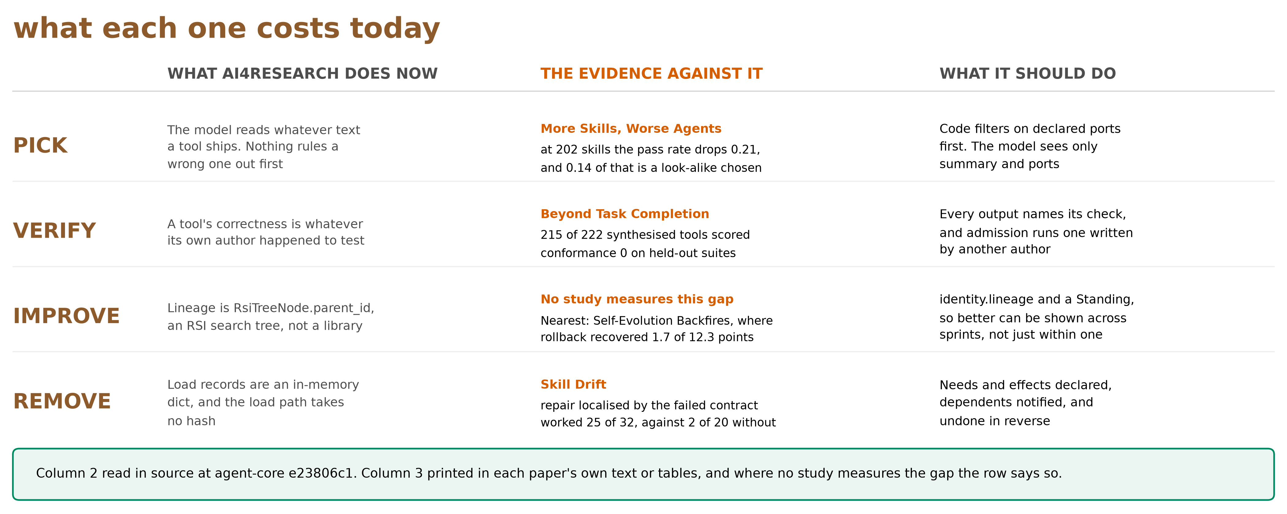
A · FUNCTION
The four verbs, today
• The previous slide said what the four verbs buy. This one reads left to right: the verb, what the platform does...
• PICK: nothing rules a wrong capability out before the model sees it
agent-core e23806c1 read in source. Study values printed in their own tables
4
Notes:
TIME 2:30
SAY: Main points:
- The previous slide said what the four verbs buy. This one reads left to right: the verb, what the platform does now, the evidence against doing it that way, and what a declaration changes
- PICK: nothing rules a wrong capability out before the model sees it
- VERIFY: a tool's correctness is whatever its own author happened to test
- IMPROVE: the only lineage is RsiTreeNode.parent_id, which is an RSI search tree rather than a library, so nothing survives the end of a sprint
- REMOVE: load records are an in-memory dict and the load path takes no hash, so nothing knows what depends on what
- The right column is what the declaration changes in each case, and none of it needs a new engine
Supplemental points:
- The evidence column, and every number in it is printed in that paper's own text or tables. More Skills, Worse Agents: at 202 skills the pass rate drops 0.21, and 0.14 of that is a look-alike being chosen rather than context length
- Beyond Task Completion: 215 of 222 synthesised tools scored conformance 0 on held-out suites
- Skill Drift: repair localised by the failed contract worked 25 of 32 times, against 2 of 20 with no localisation
- Say the IMPROVE row honestly. No study measures that gap directly. It is read in source. The nearest measured thing is Self-Evolution Backfires, where rolling back the harmful skills recovered only 1.7 of a 12.3-point drop, which is about cleaning up late rather than about lineage
- Why the third column was relabelled as evidence on 2026-09-24: it previously read as a cost, which invited the question of where the cost came from. Naming the study above each number answers that before it is asked, and it exposed that one of the four rows has no study at all

